Slide 1
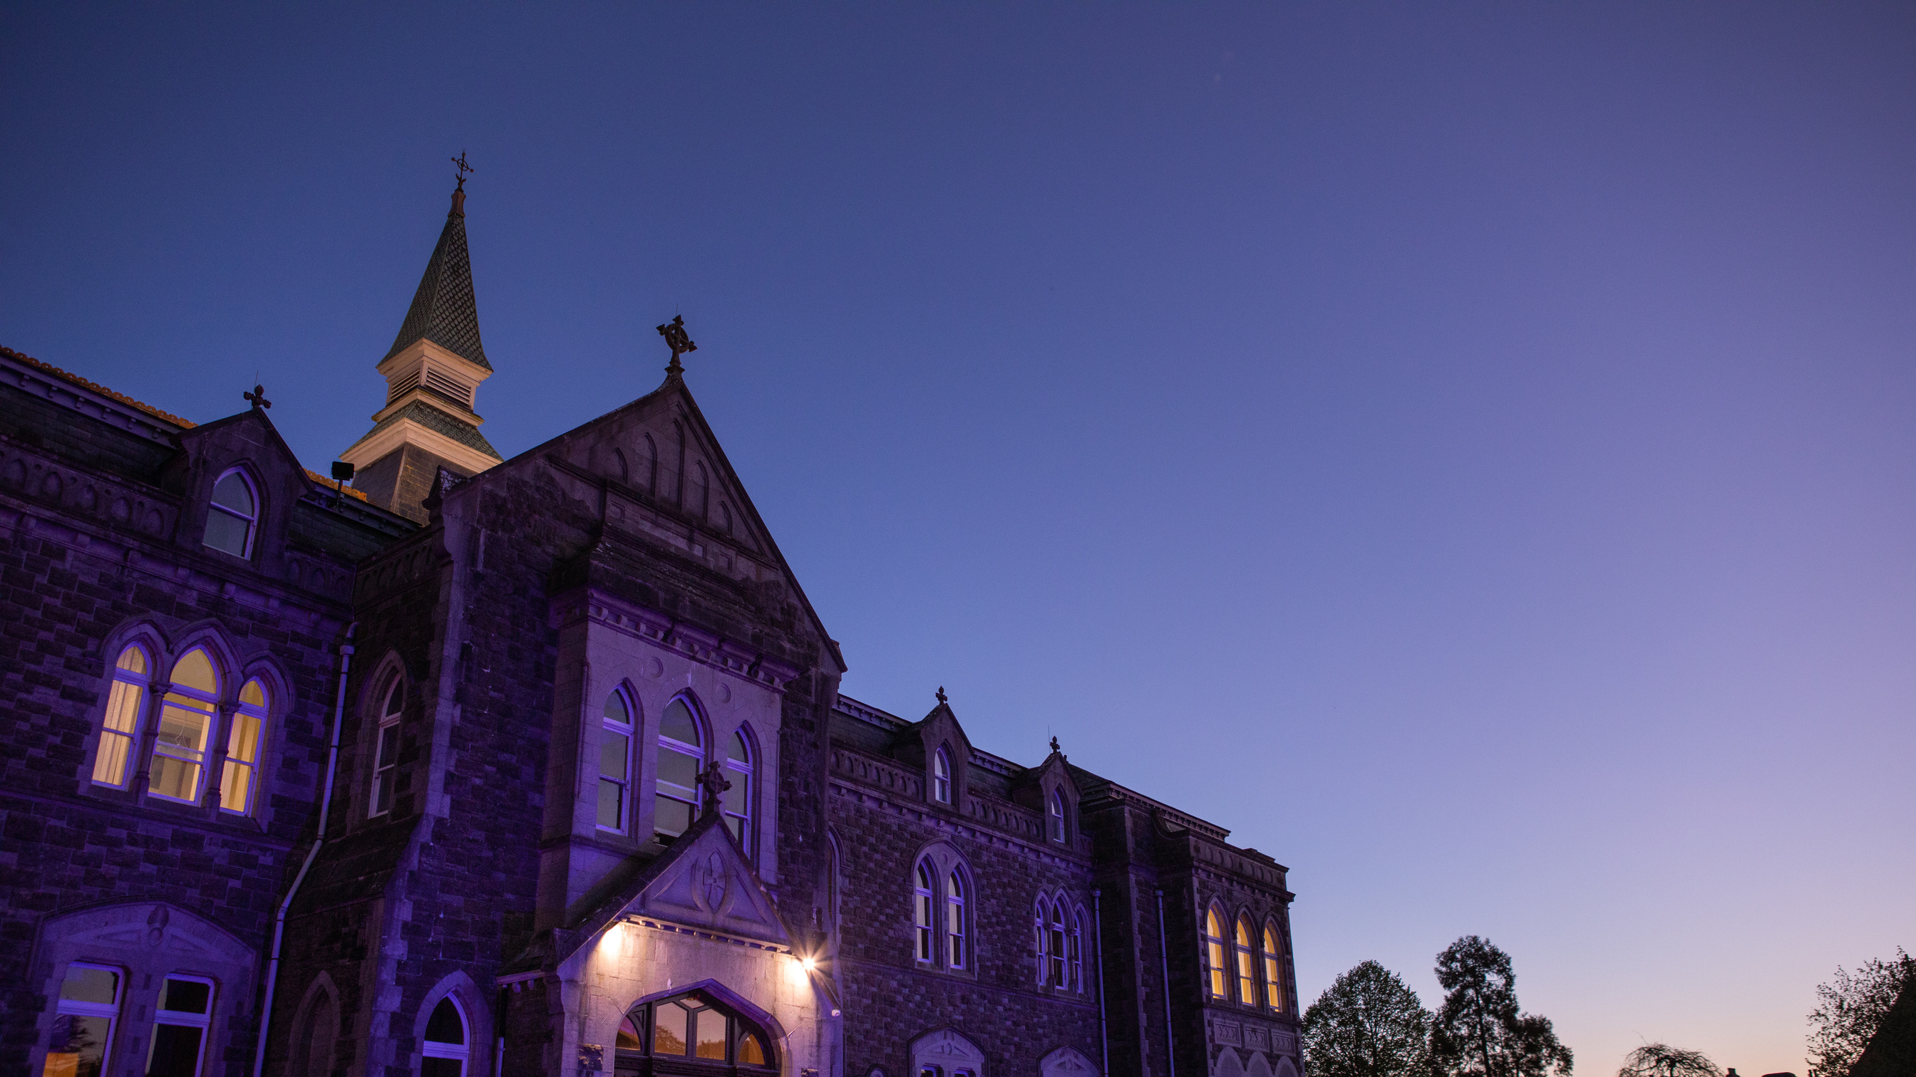
Transition Year Programme
2022 - 2023
Presentation evening

Slide 2
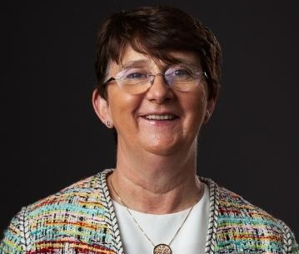
Facilitates smooth transition from dependant learning to Independent self-directed learning.
Transition Year Coordinator
& Deputy Principal
Catherine Smyth

Slide 3
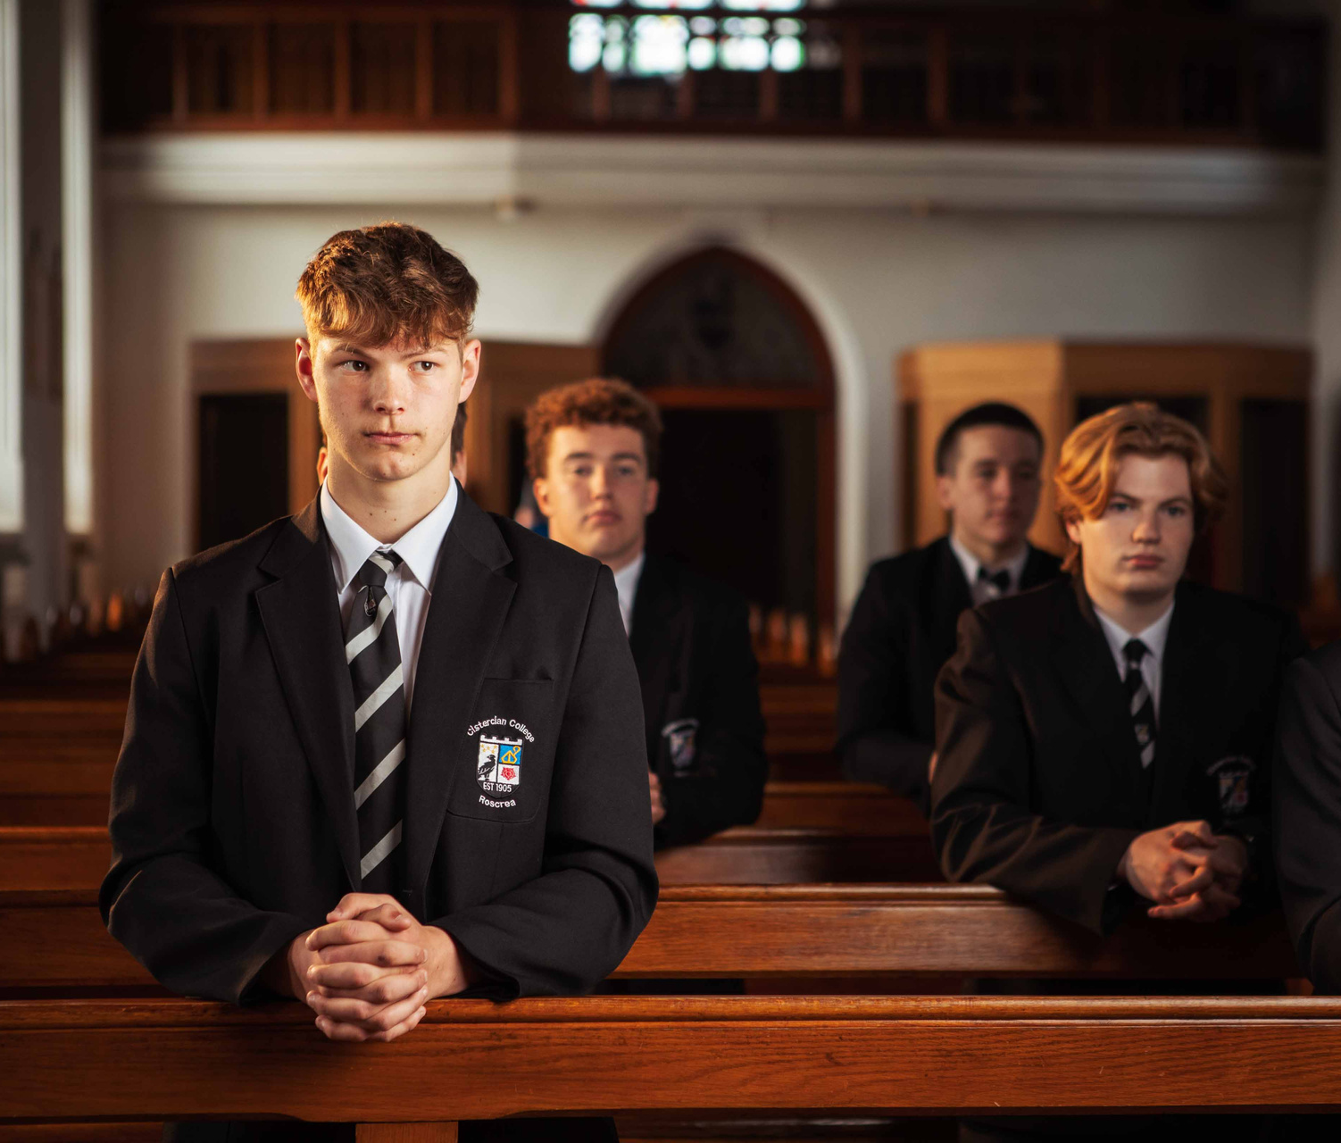
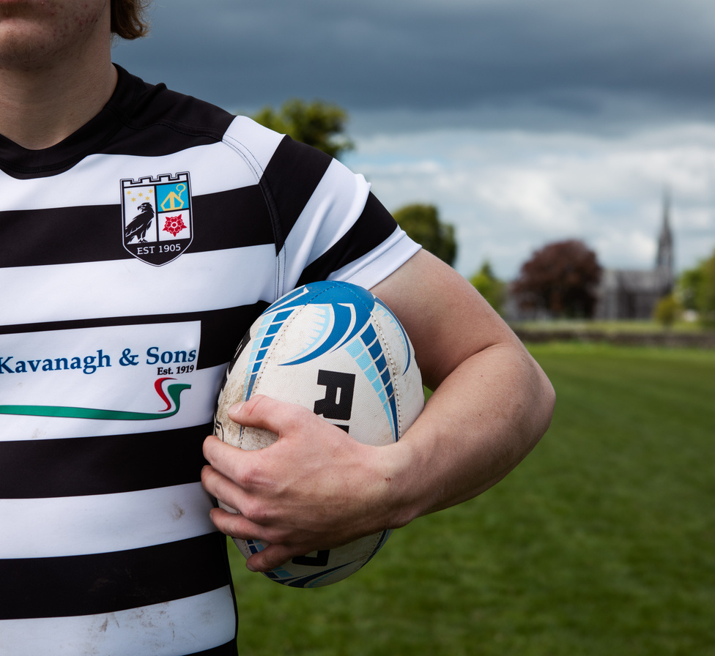
Facilitates smooth transition from dependant learning to Independent self-directed learning.
One Year Programme
Facilitates smooth transition from dependant learning to Independent self-directed learning
Normal Class Structure
Workshops and activities superimposed on a normal class structure providing full range of subjects

Slide 4
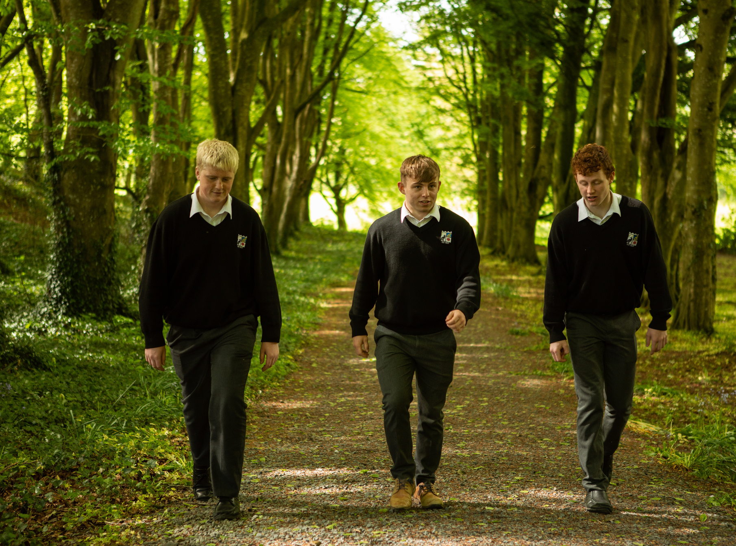
Aims of Transition Year
Encourage personal development, self-esteem and maturity
Promote maturity in studies making students more independent, self-directed and confident for senior cycle.
Increase the social and personal awareness of students
Extend each student’s range of interests and activities

Slide 5
Why consider Transition Year?
Challenges Facing Students
Leaving Certificate and Points
Third Level
Adult and Working Life

Slide 6
Leaving Certificate and Points
Informed subject choice
Informed C.A.O. choices
Do better in Leaving Certificate by an average of 30 points
More likely to retain subjects at higher level
More prepared for senior cycle

Slide 7
Studies on Transition Year
Aidan Clerkin, Education Research Centre Drumcondra
Students who do Transition Year (TY) engage better with their studies for the Leaving Certificate than those who do not.
Students' TY participation status was among the strongest predictors of spending more time on homework." He said it was likely that the TY programme developed students' self-regulatory and self-management skills.

Slide 8
Assessment & Accreditation
Progress reports at October, Christmas,Easter and Summer.
Academic subjects examined by project method.
Modules delivered by others are certified.
Work experience is monitored and assessed.

Slide 9
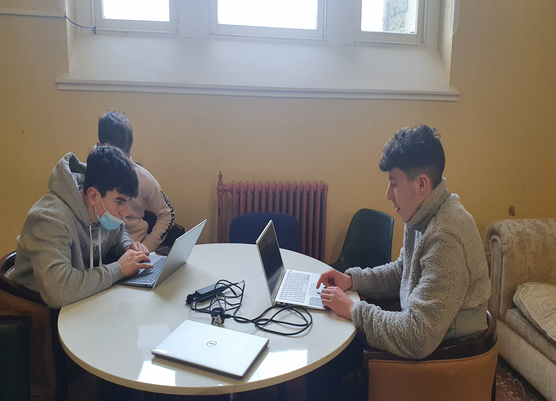
Academic
Full range of subjects offered Core Subjects (Irish, English and Maths)
French/German/Irish language exchange
Other subjects modular
Content linked to leaving certificate syllabus
Use of field work and projects.

Slide 10
Links to Leaving certificate
Maths topics all linked to new Project Maths course – higher numbers from TY stay in LC HL – 25 points
Irish – Preparation for oral, worth 40%, covered in TY
English – improved vocabulary, comparative studies, creative writing
Modern languages – French, German and Spanish
Language exchange and preparation for LC orals and aurals worth 45%
Business – Material from Business, Accounting and Economics covered, helps in selecting subjects.
Mini – companies, Student Enterprise
Science – Material from Biology, Chemistry, Physics and Ag. Science covered, helps in selecting subjects.
Individual project work and BT Young Scientist
Irish Angus Beef Competition

Slide 11
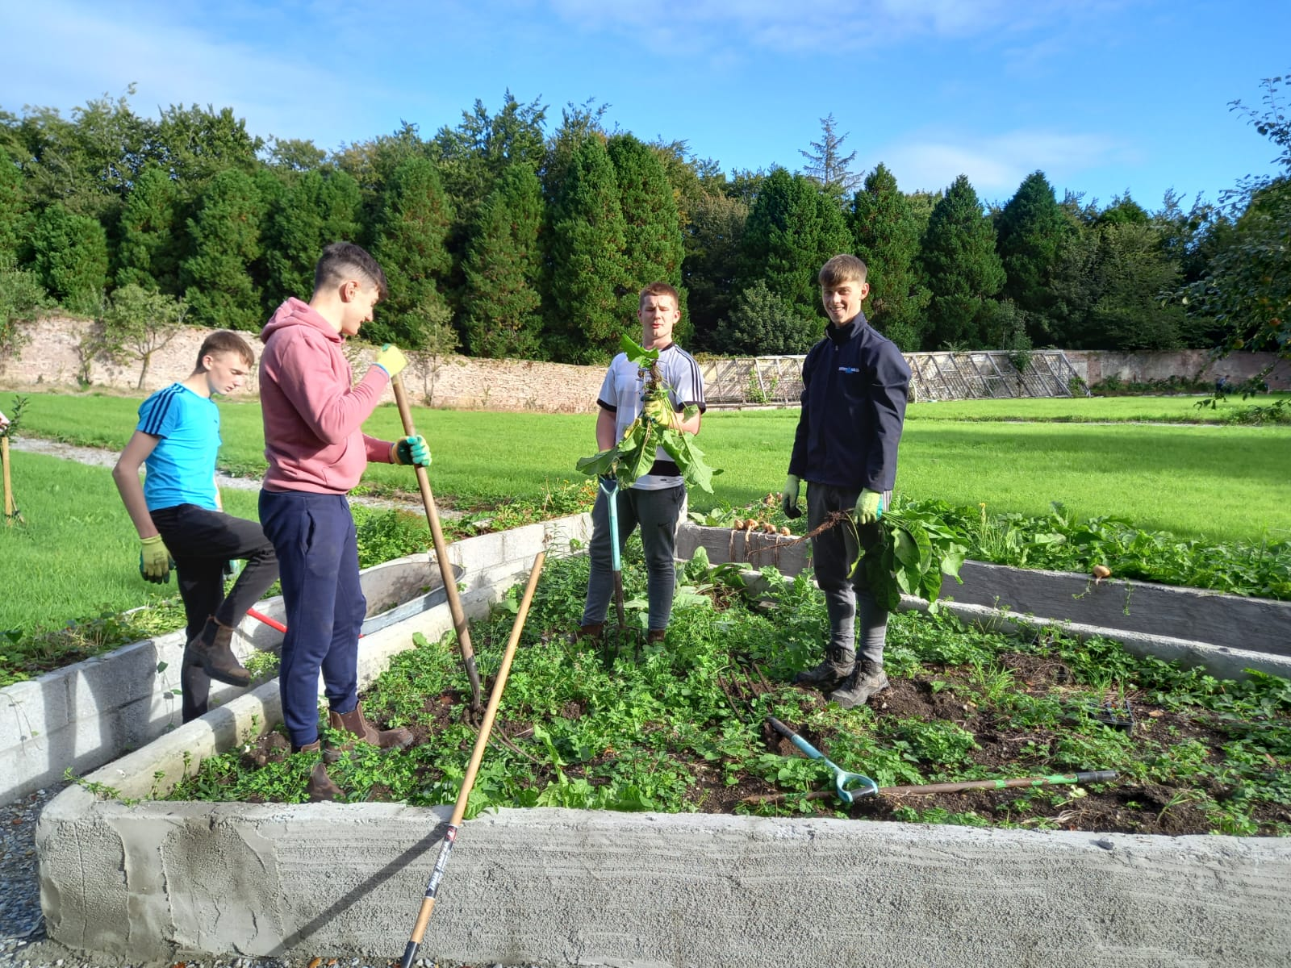
New Modules
Horticulture
Golf Academy
Climate Changemakers
Green Schools Programme
Stone work and Wood Projects
Social media & internet safety
Digital Creation
Health, wellness & mindfullness

Slide 13
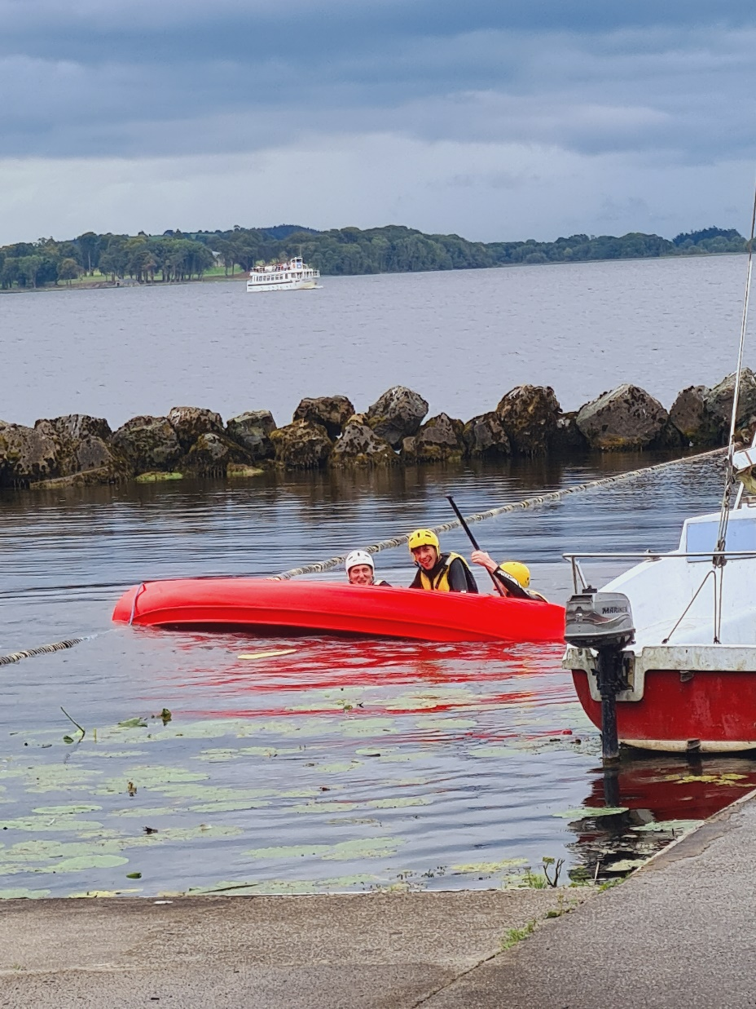
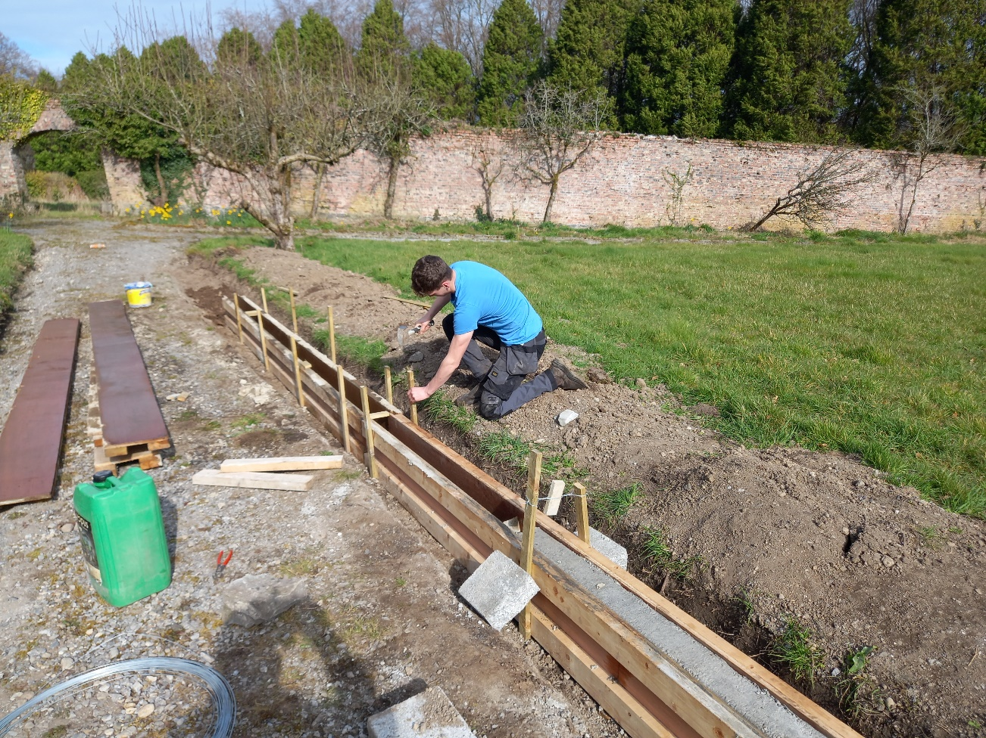
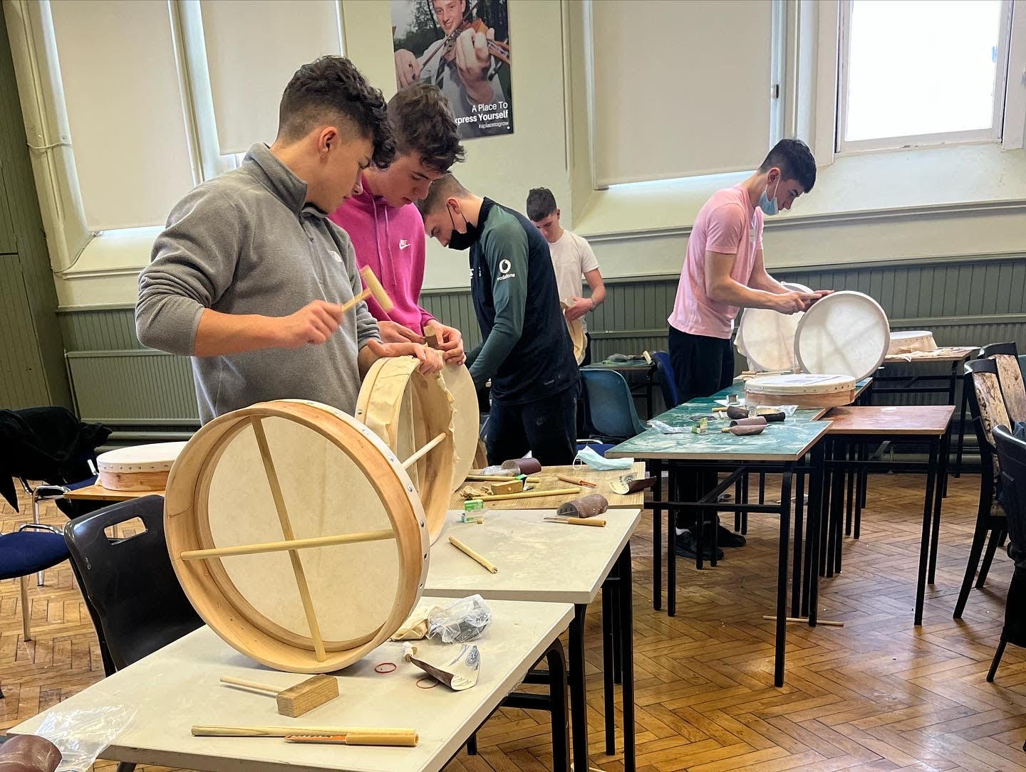
Workshops & Activities
Certificated courses
Skills Acquisition
Career Investigations
Social Personal and Vocational
Outdoor Pursuits/Leisure/Culture/Hobbies

Slide 14
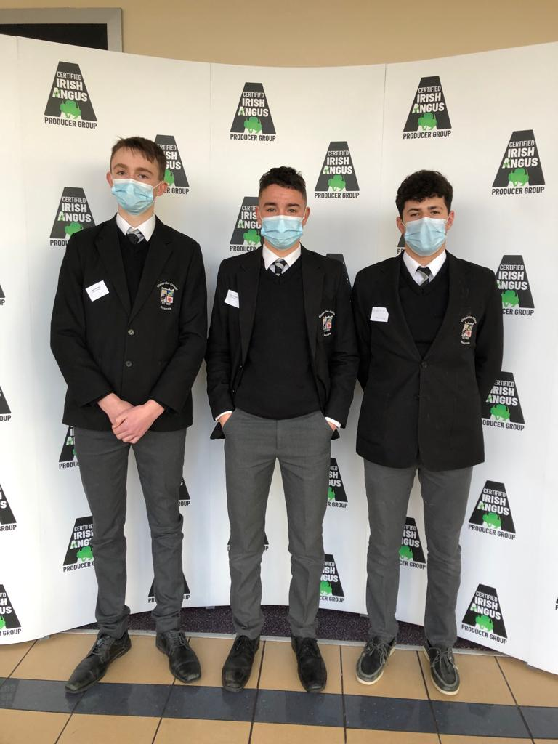
Certified Courses
ECDL
First Aid
Gáisce – The Presidents Bronze Award
Schools Digital Champion
Food Business Module (Bord Bia) online
Tourism Module online
Student Enterprise
Young Social Innovators
Future Leaders
Look into Law

Slide 15
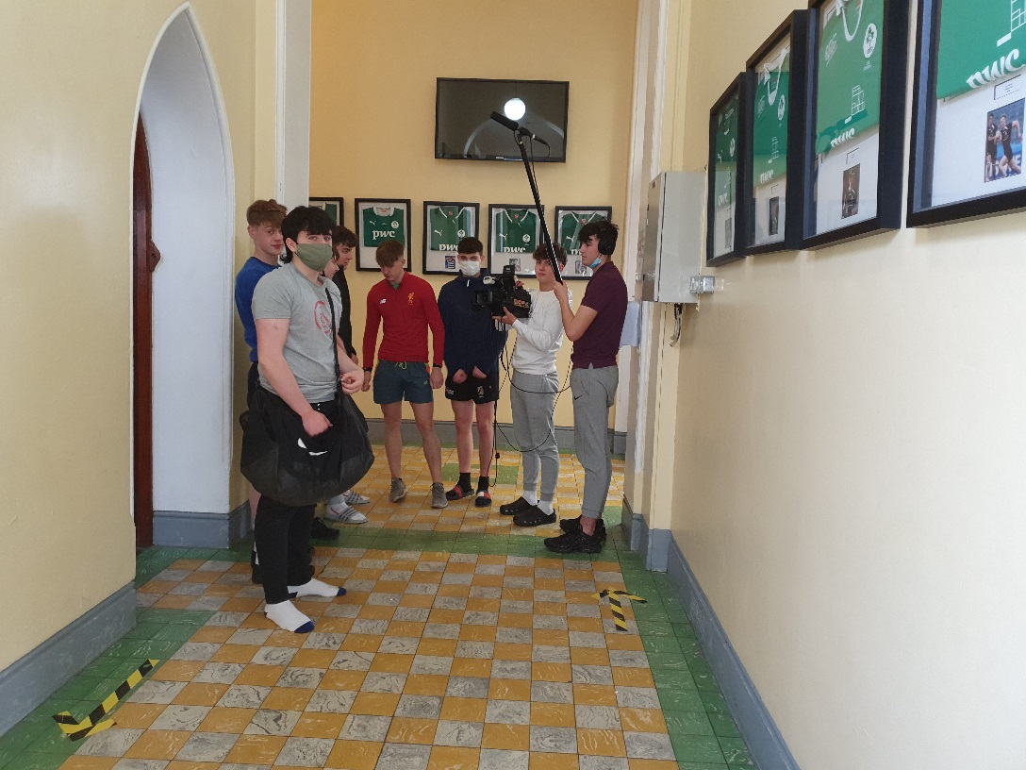
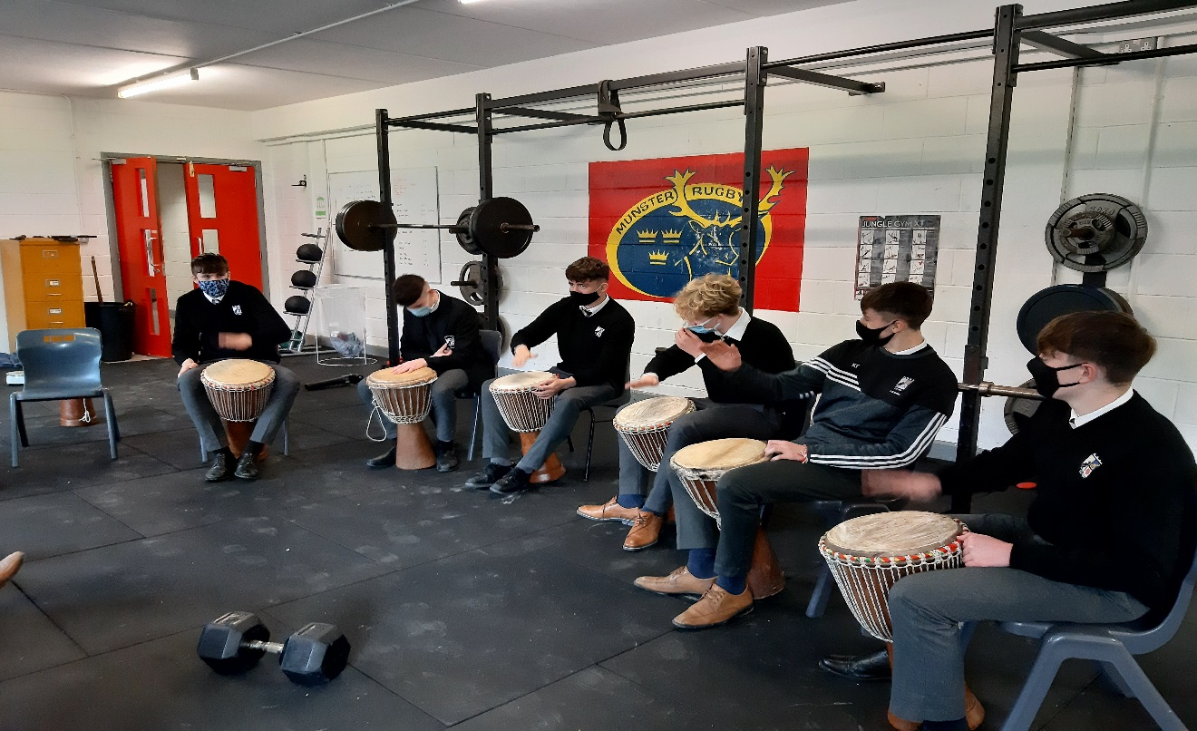
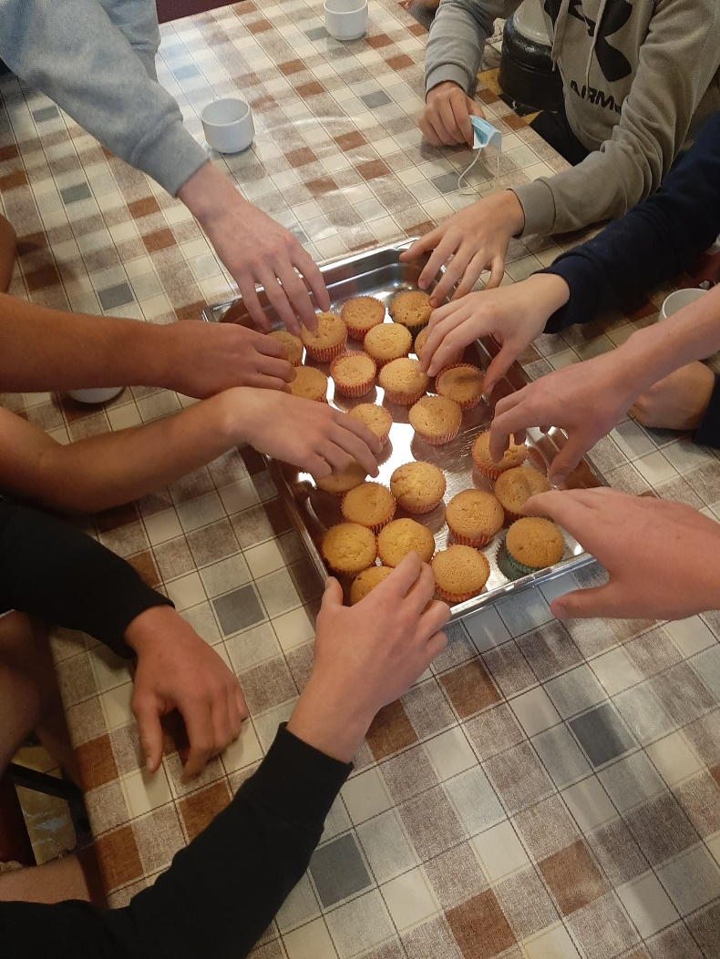
Skills Aquisition
Cookery
Driver Education
Public Speaking
Irish Language Promotion
(Seachtain na Gaeilge)
Live action film making
Creative Writing
Drama and Music

Slide 16
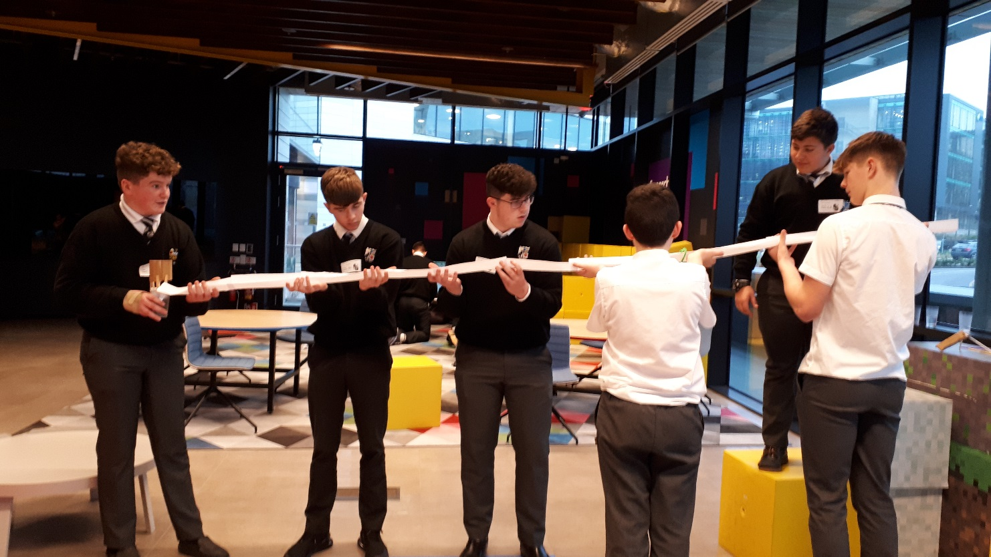
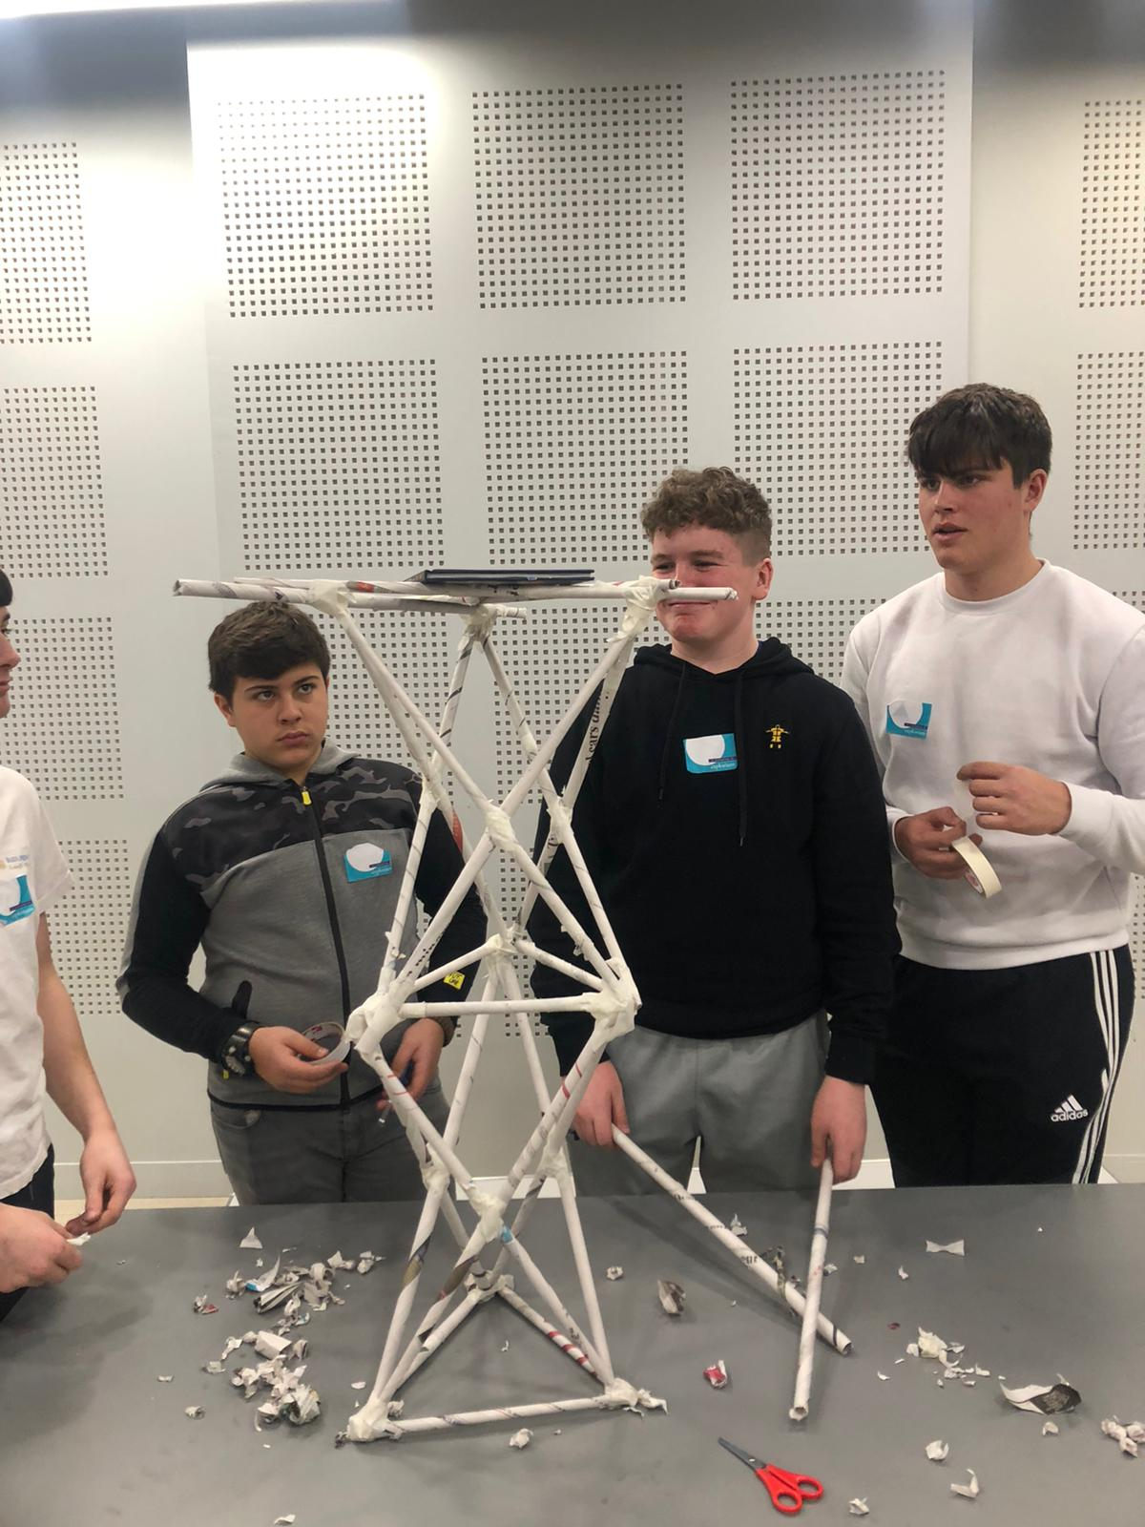
Careers promotion
Work Experience
Engineering (Vistakon,Microsoft, Boston Scientific, Steps Programme)
Career presentations ( Colleges, Defence Forces)
University Taster Programmes (DCU, UCD, Trinity, RCSI, UCC) Facilitated
Law Module ( Bar of Ireland Lottery)
Stockmarket Module
UCD/UL/UCC Campus Tour
Guest Speakers
Institute of Chartered Accountants

Slide 17
Social, Personal and Vocational
Law Module delivered by the Public Access to Law programme
Dr. McCarthy Perpetual Trophy for Achievement in Science
General Health and Welfare(workshops on mental health and emotional well being, healthy eating and nutrition)
Social Media workshop ( Online behaviour and cyber safety
Comhairle na N-óg
Two Weeks Work Experience
TY Retreat
Establishing and Running Mini-Companies
Charitable and Social Work (Pieta House, Cystic Fibrosis, Jigsaw, Penny Dinners, Darkness into Light, Fr Peter NcVeery Trust)
Prayer Path/ Walled Garden (On site, hands on activity)
Irish Aid Centre

Slide 18
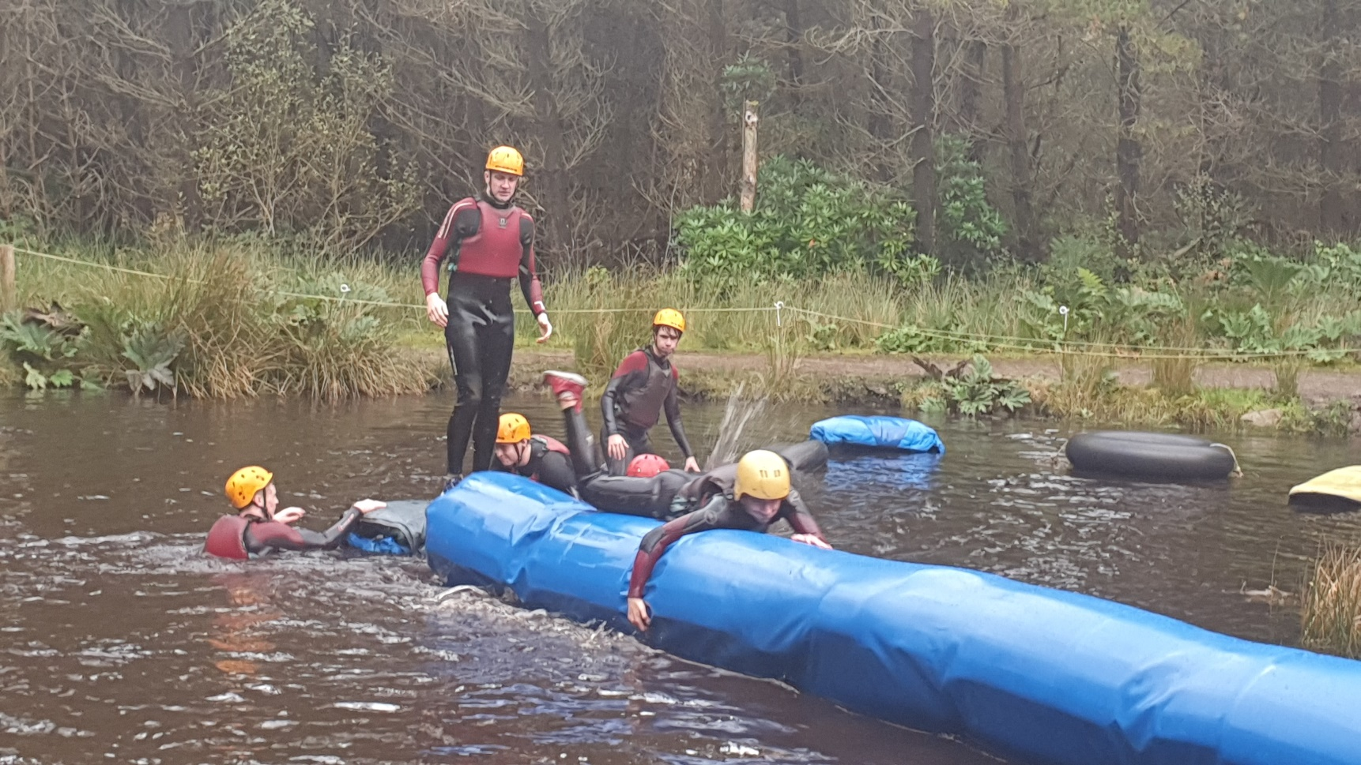
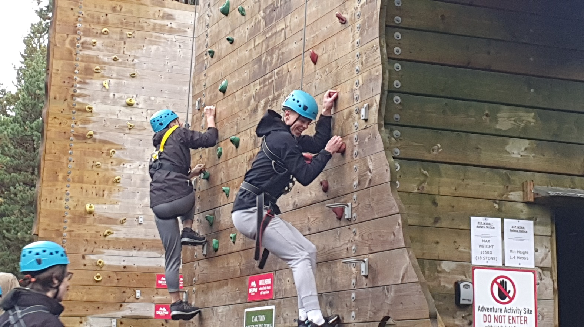
Outdoor Pursuits, leisure & hobbies
Language programme
Swimming and Life-Saving
Horticulture
Pilates
Horse riding/Skiing/Surfing/Fencing
Adventure Centre activities
Leadership and Team Building
European School Tour
Cultural Trips (theatre, history, musicals)

Slide 19
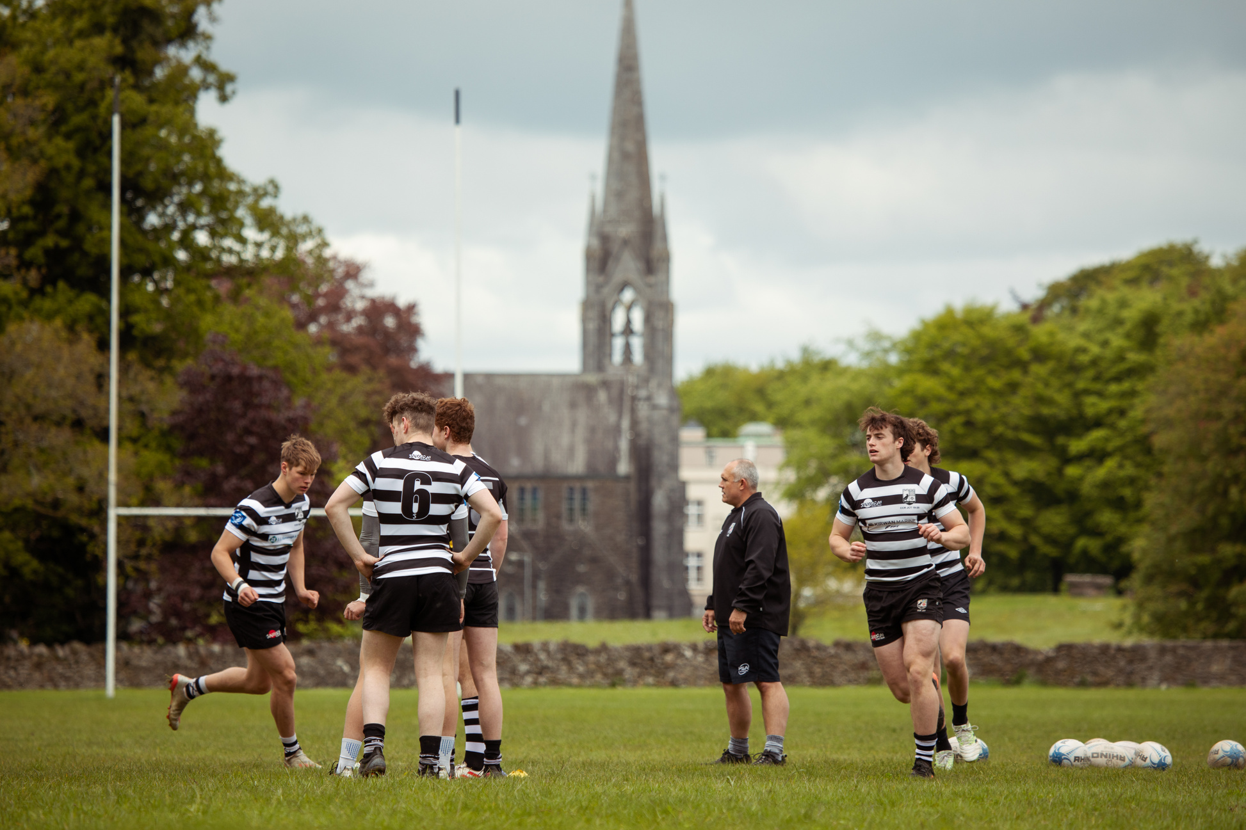
Sport
Hurling
Rugby
Soccer
Gaelic Football
Golf
Tennis
Athletics
Basketball
Horse Riding
Skiing
Surfing
Pilates

Slide 20
Music
Musical
Choir
Orchestra
Lessons in various instruments
Percussion workshops

Slide 21
Cost of the programme
There is some additional expenditure associated with the Transition Year programme.
Modules delivered by people who work in the discipline
Nature of the activity necessitates it taking place outside the school. The School strives to minimise expense by delivering as many modules as possible in-house.

Slide 22
TESTIMONIALS
"I really enjoyed my time in Transition Year. Throughout the year, I had loads of different experiences which helped me to choose what subjects I wanted to do in Senior Cycle. My work with my mini-company , gave me a huge interest in business, which is now something that I plan to pursue in College. Transition year helped to develop new skills and find new passions."
Séan Treacy, TY 2019 - 2020

Slide 23
TESTIMONIALS
"I really enjoyed my time in Transition Year. Throughout the year, I had loads of different experiences which helped me to choose what subjects I wanted to do in Senior Cycle. My student enterprise project , gave me a huge interest in business. I also had the opportunity to do a TY engineering workshop with the ESB under the STEPS programme. Transition year helped to develop new skills and find new passions."
Josh Powell, TY 2021 - 2022

Slide 24
TESTIMONIALS
"Transition Year for me was a great learning experience and I am so glad that I did it. There is something for everyone in Transition Year and so much to get involved in and you will see the rewards if you get involved in as much as you can. My highlight of the year was being involved in the Angus Beef Competition."
Colm Lynam, TY 2021 - 2022

Slide 25
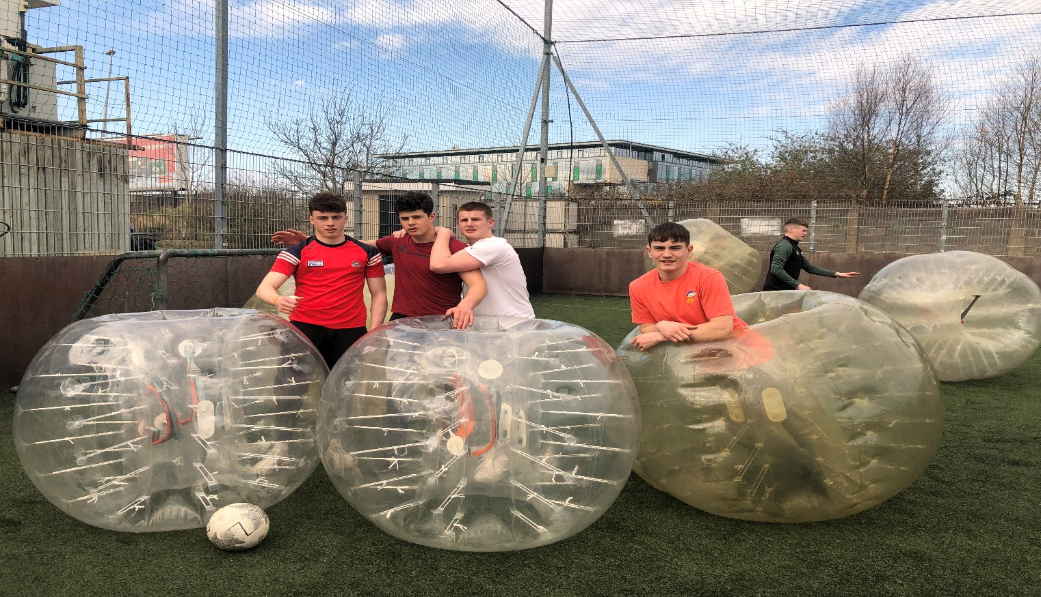
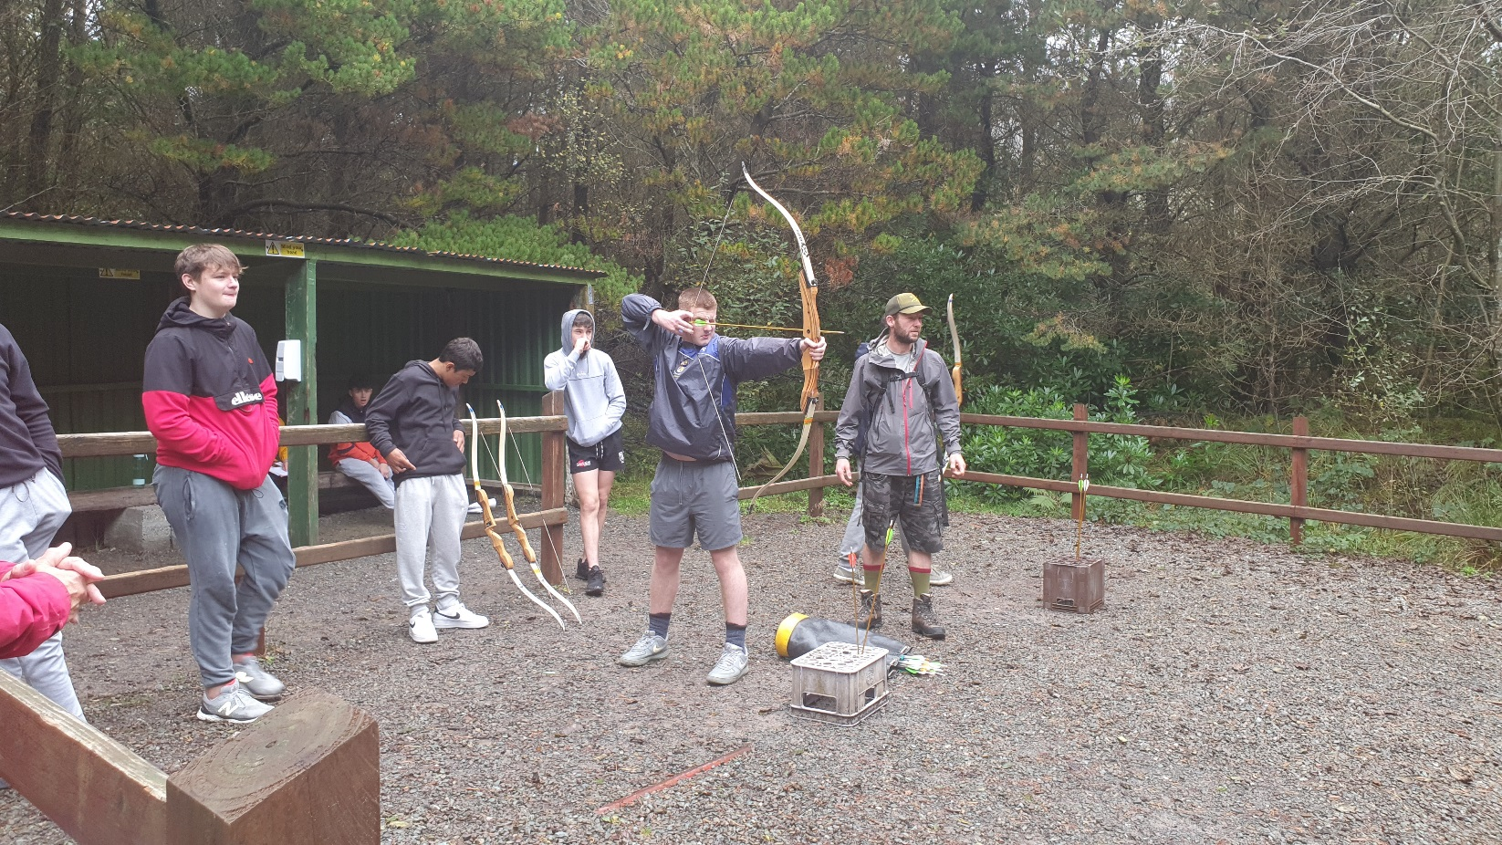
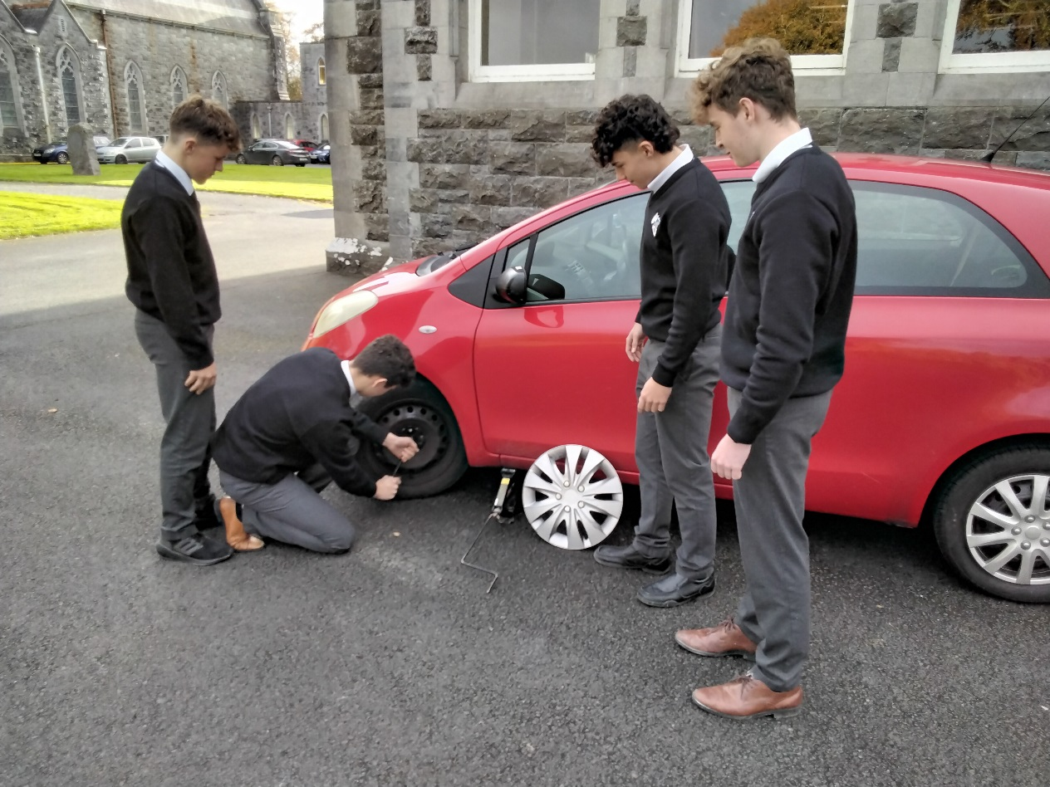
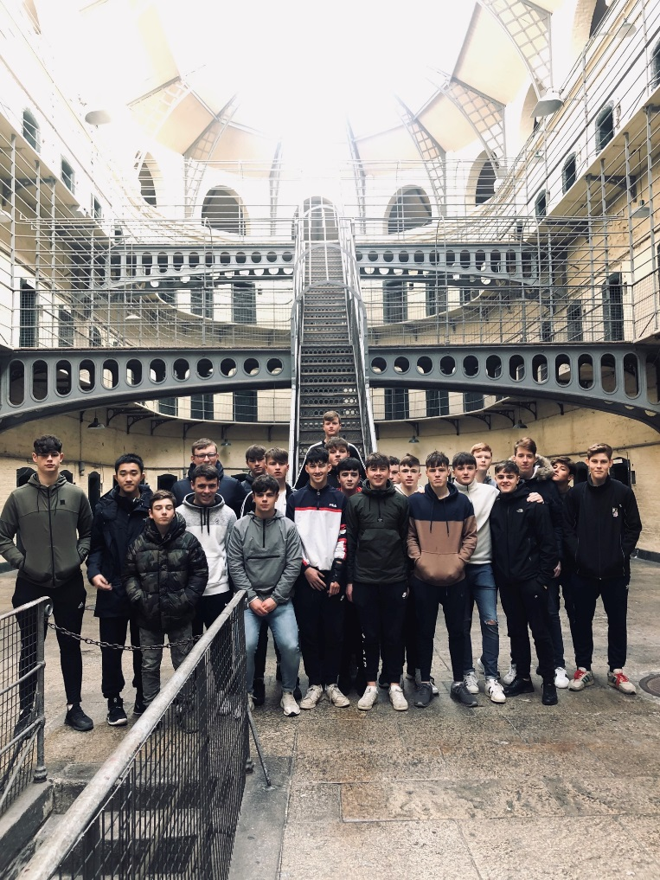
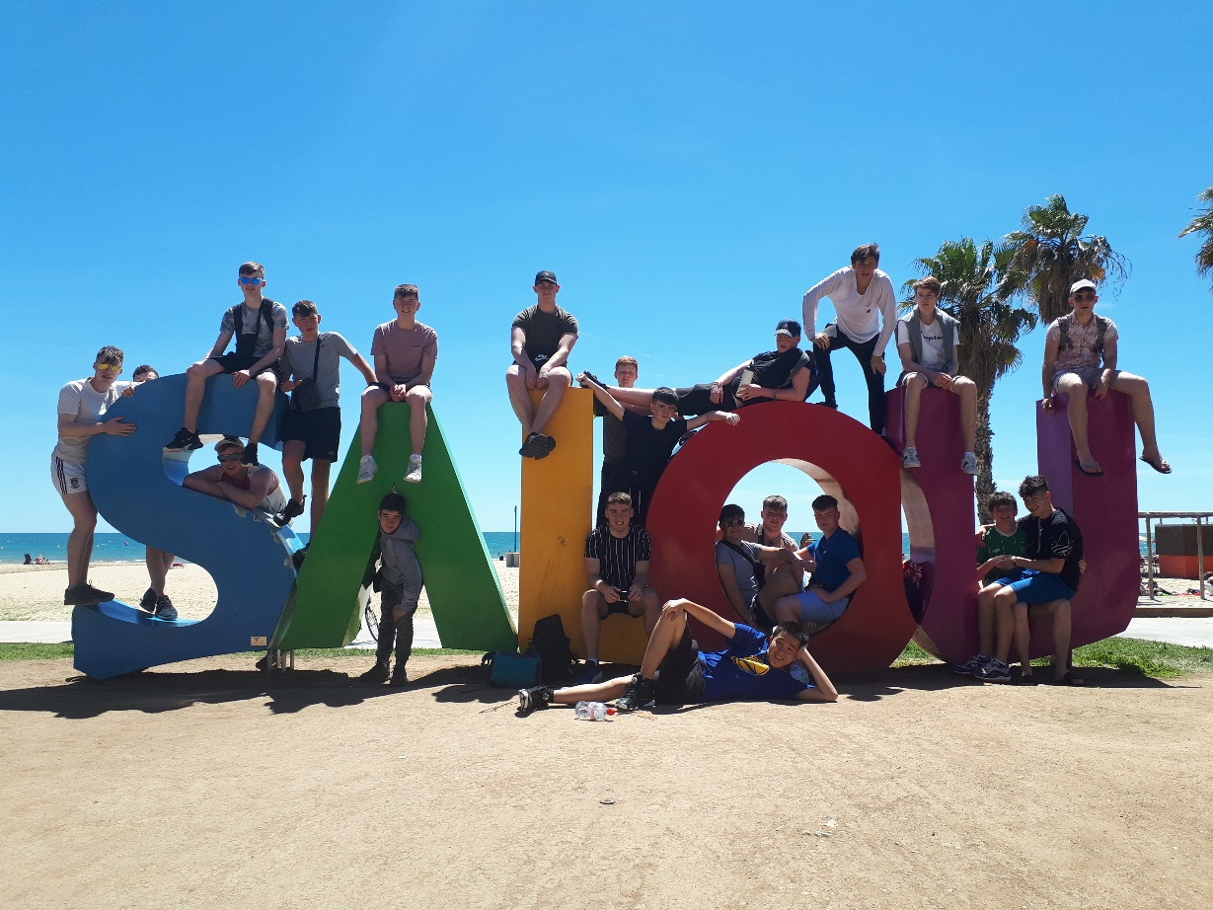
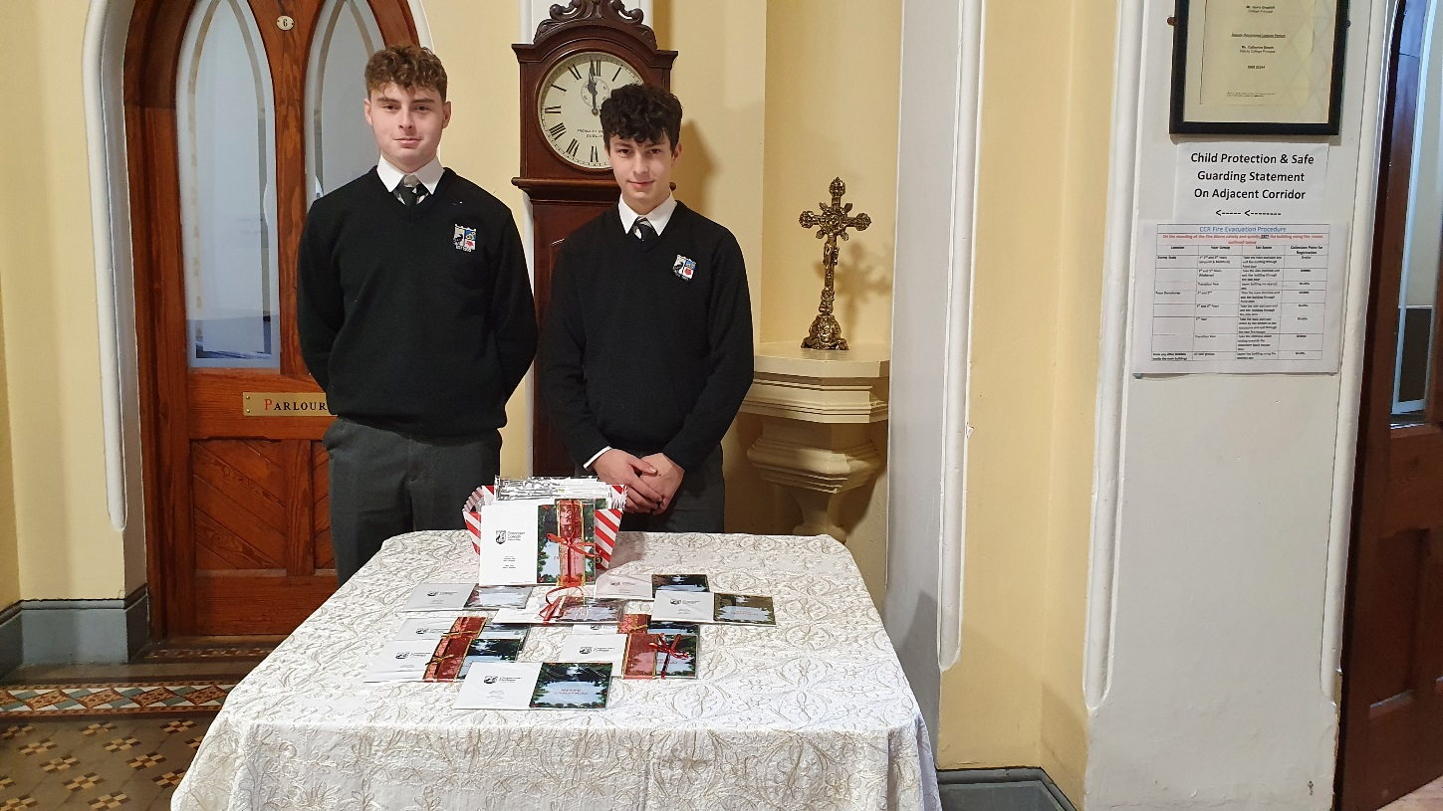
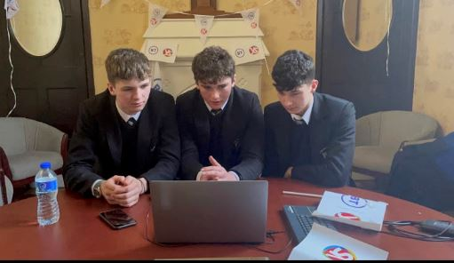
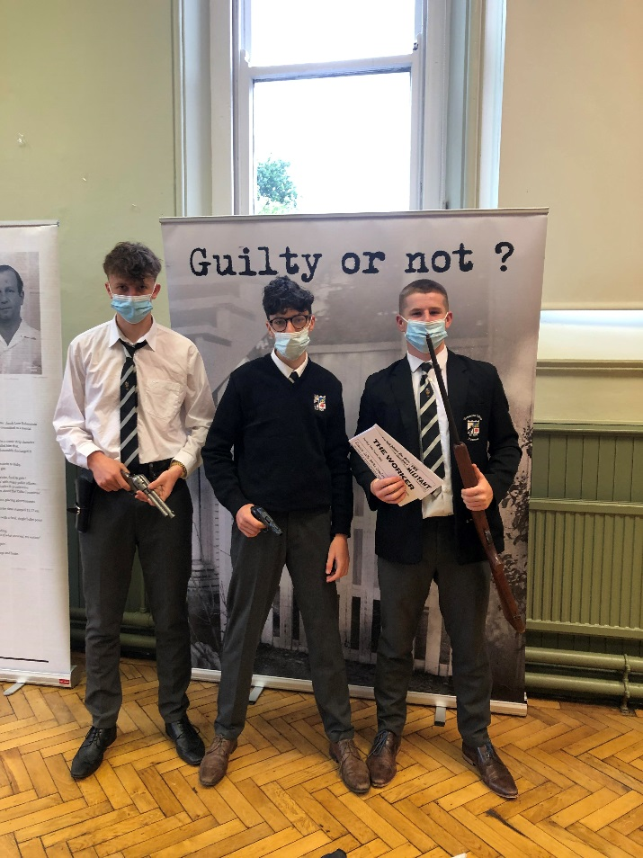
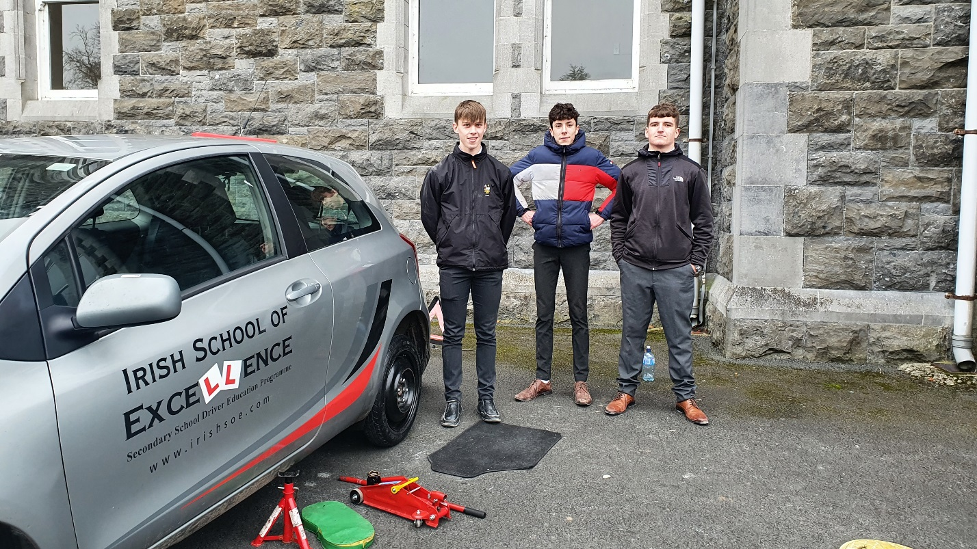
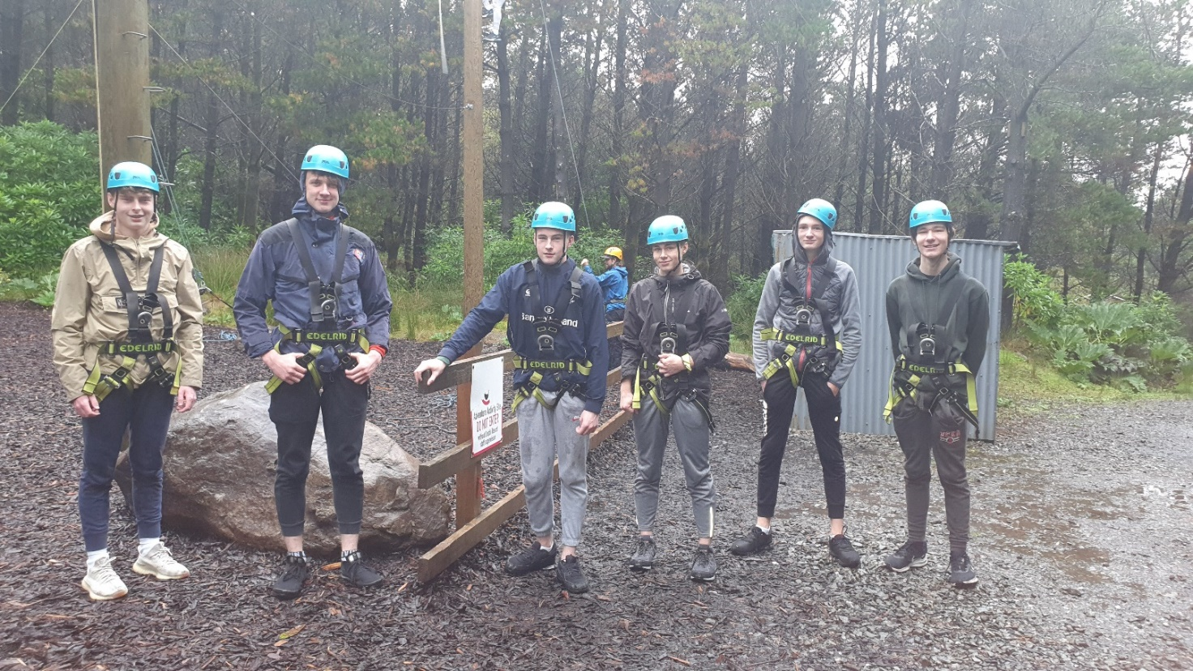
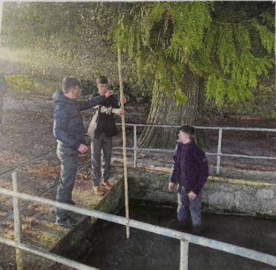
PHOTOS

Slide 26
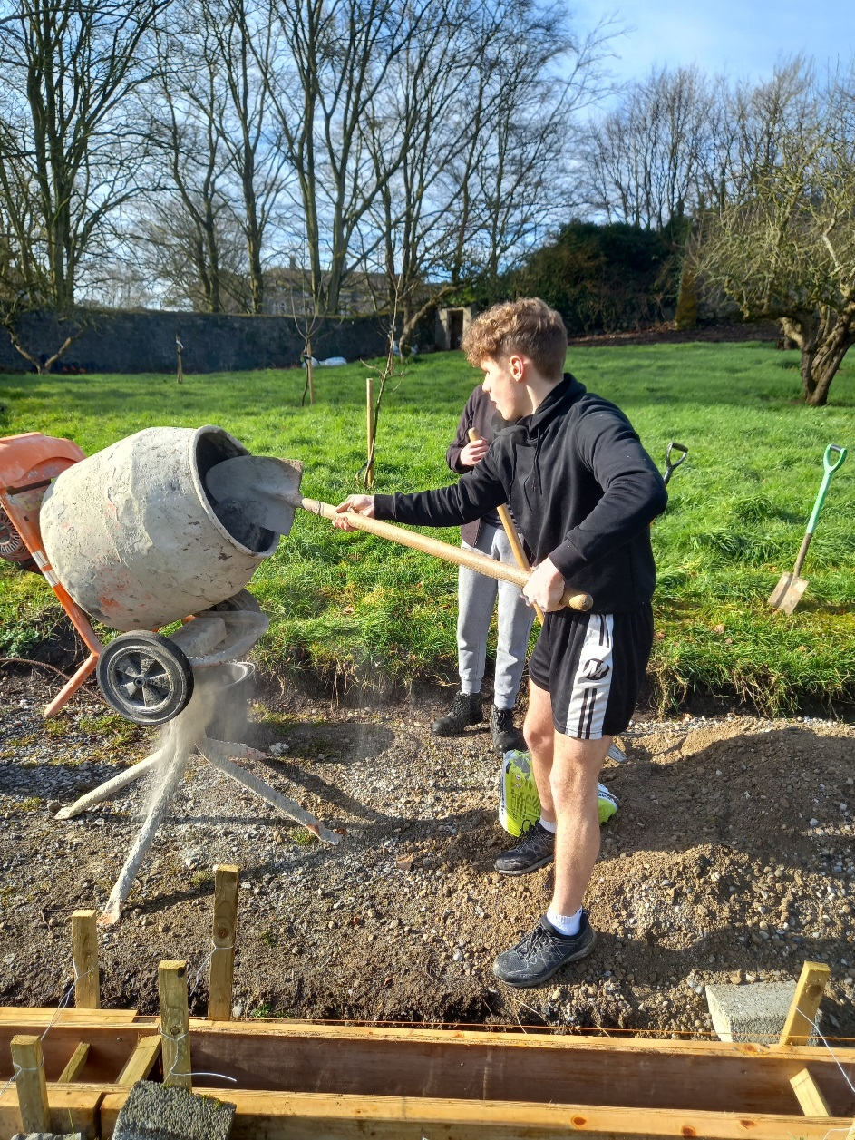
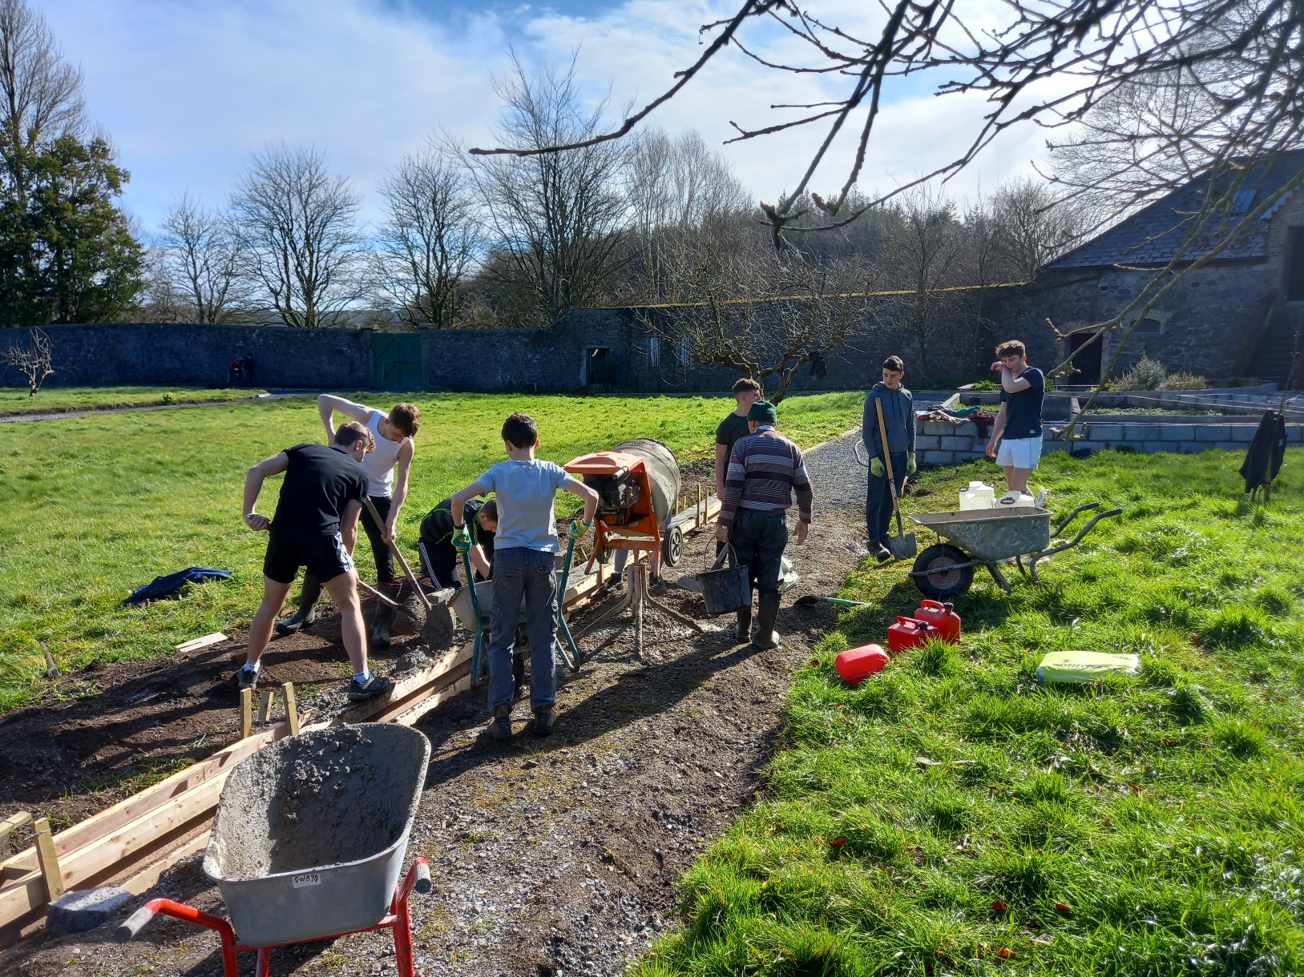
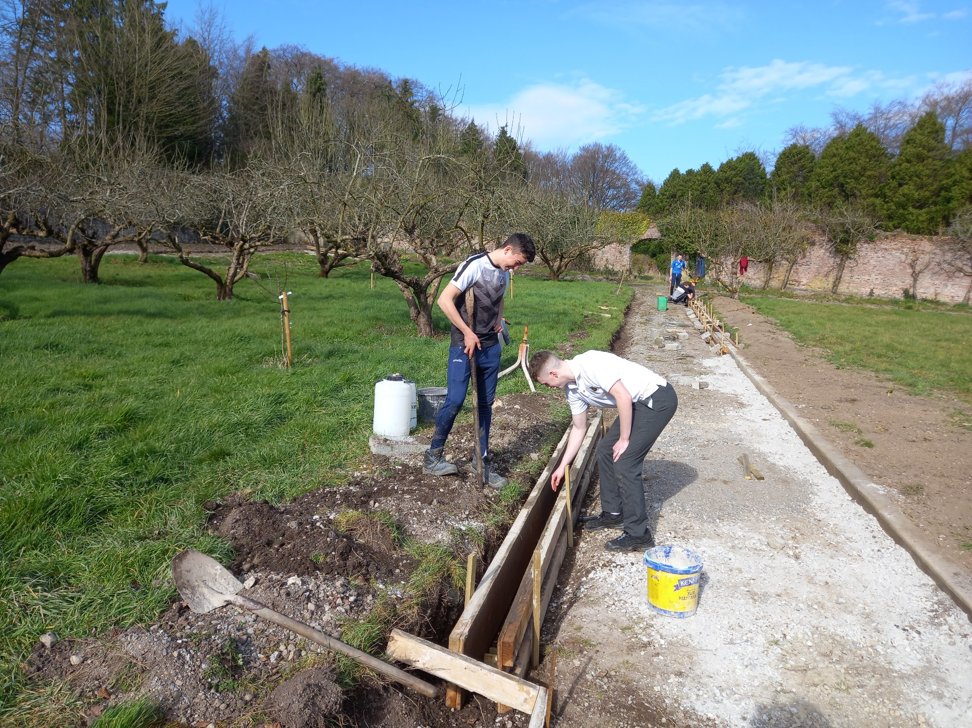
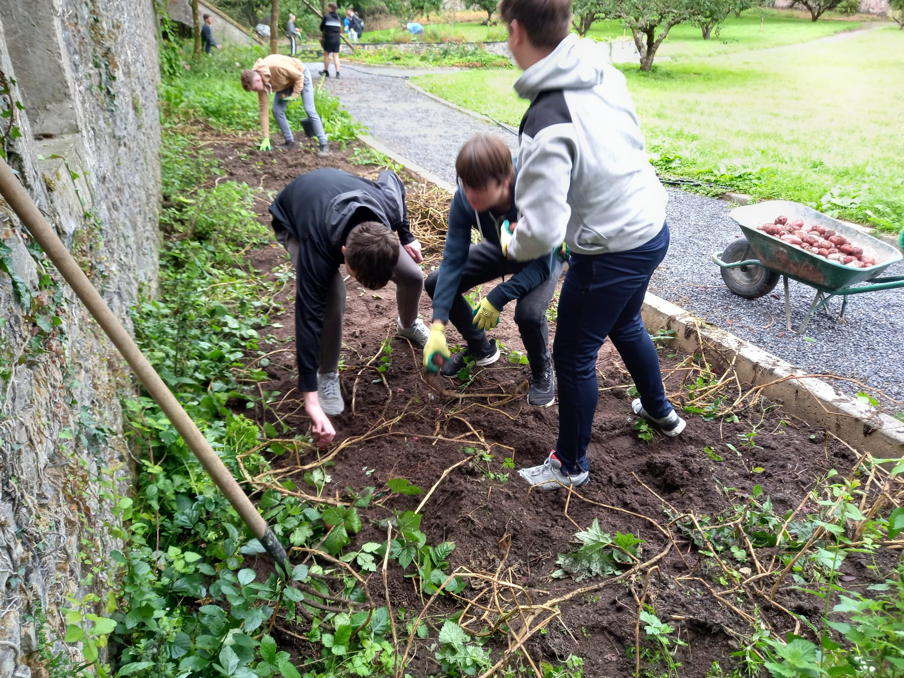
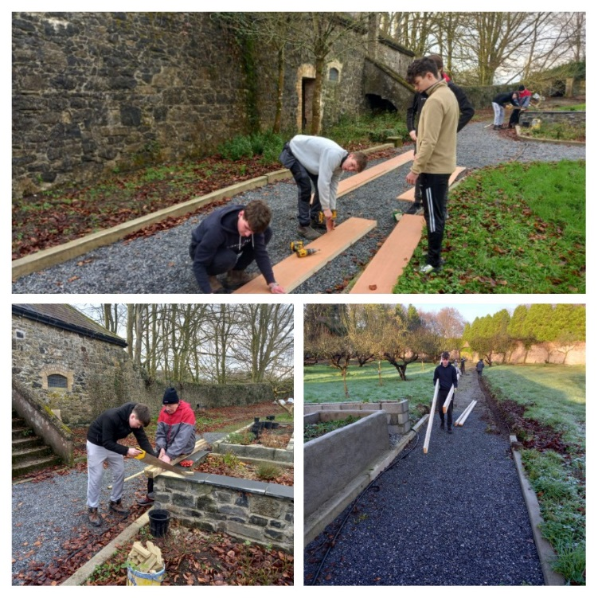
PHOTOS

Slide 27
Walled Garden

Slide 28
Walled Garden

Slide 29
Cisterican College Transition Year Programme
A Year to grow
We wish you all of the best with your choice

